Slide 1
The UniBoard a RadioNet FP7 Joint Research Activity
Arpad Szomoru, JIVE

Slide 2
Overview
Background, project setup
Current state
UniBoard as SKA phase 1 correlator/beam former
Future: UniBoard²

Slide 3
The aim
Creation of a multi-purpose scalable high-performance computing platform for radio astronomy
Originally proposed by Sergei Pogrebenko in late 90s, as a single-board all-station correlator, became basis of project in 2007
Combine as much CPU and as much I/O as possible on a “reasonably” sized board (Pogrebenko melt-down criterium)
Use standard interfaces as much as possible
Only digital, nothing analog...
Develop several different applications at same time, force design to be as generic as possible

Slide 4


































The project
EC contract nr 227290
UniBoard: a RadioNet FP7 Joint Research Activity, 9 partners, kicked off January 2009
JIVE: project lead, VLBI correlator
ASTRON: hardware development, test firmware
INAF, University of Bordeaux: digital receiver
University of Manchester: pulsar binning machine
University of Orléans: RFI mitigation algorithms
KASI: VLBI correlator
ShAO: digital receiver, VLBI correlator
University of Oxford: all-dipole LOFAR correlator
Strong support from collaboration, large amount of matching effort, financial contribution

Slide 5
Supporting projects
ExBox: Expandable Box for X-correlation
  JIVE/ASTRON proposal to NWO
Build prototype FPGA EVN/APERTIF correlator
  Using LOFAR expertise and technology
  Backplane with several boards
  Matching funds for UniBoard
NWO - ShAO collaborative agreement
  Stimulate collaboration between JIVE and ShAO in the development of FPGA-based correlators and VLBI space science applications
  Several positions: students, postdoc, engineer

Slide 6
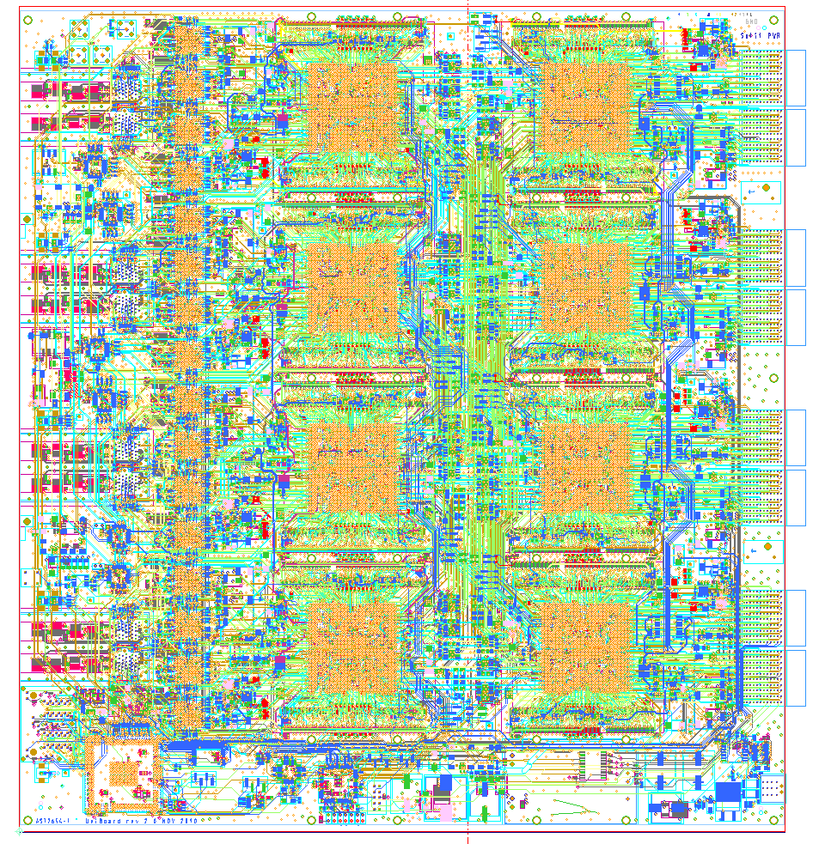
The design
14 Layers
340x366mm
7304 components (47% of board space in use)
25798 connections
271 meter traces

Slide 7
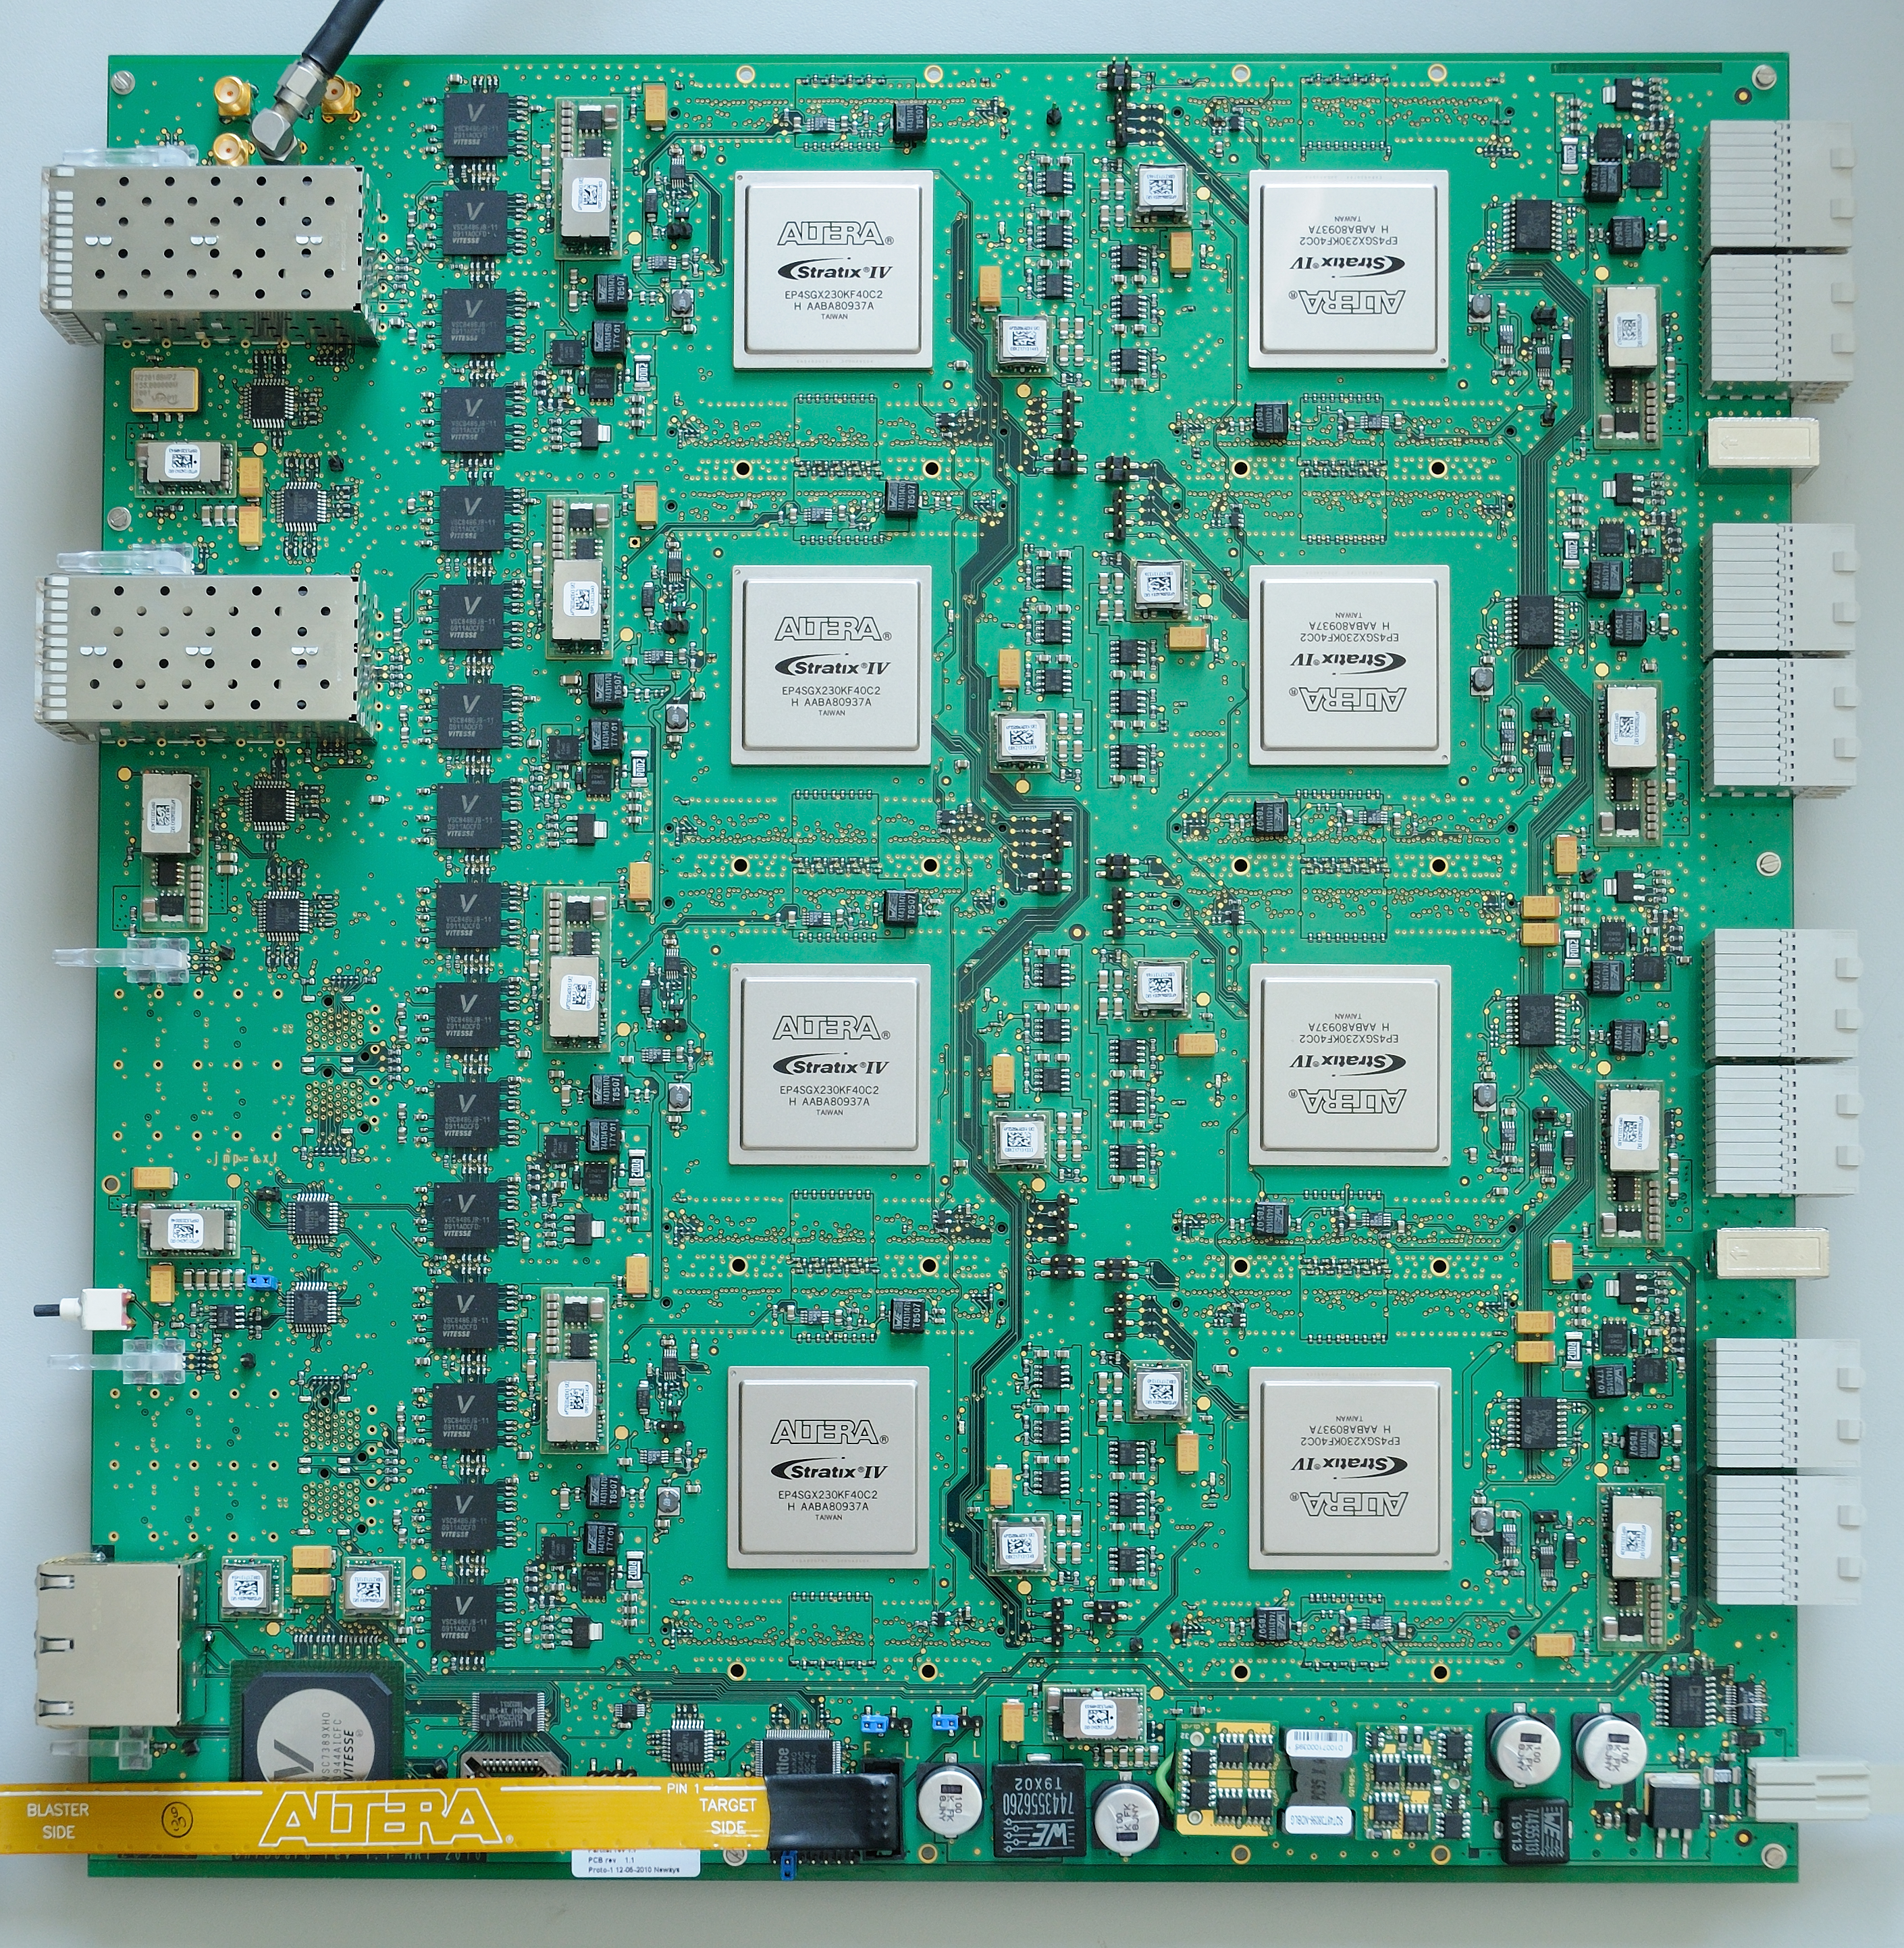
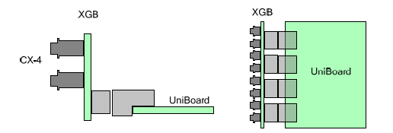
The result
Per board: 8 Altera Stratix IV FPGAs (40 nm,1288 18x18 multipliers, 400MHz, ~0.5TMAC/s)
Per FPGA: 2 DDR3 memory banks (on backside of board)
Four times four 10-GbE links connect to the front nodes via four SFP+ cages
high speed mesh connects each front node to all back nodes
The back nodes in their turn connect via four times four 8-bits LVDS to a backplane connector
a 10G break-out board (the XGB) has been designed in the form of a mini-backplane, with a total of 16 CX4 connectors
Prototype delivered May 2010, production run completed

Slide 8
Applications under development
Currently under development:
  VLBI correlator (JIVE)
  digital receiver (INAF, BORD)
  pulsar binning machine (UMAN)
  RFI mitigation (UORL)
Coming soon:
  APERTIF correlator (ASTRON)
  APERTIF beam former (ASTRON)
  AARTFAAC all-dipole LOFAR correlator (ASTRON + University of Amsterdam)
  all-dipole LOFAR correlator (Oxford)
  ShAO 65 meter telescope backend
  Chinese/Korean VLBI correlators
  more applications on the way

Slide 9
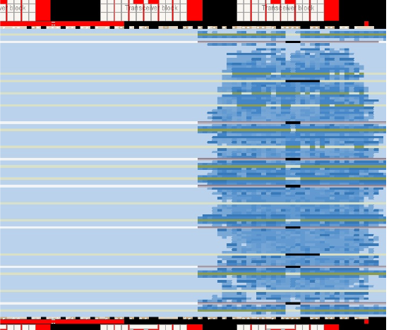
Current effort in Dwingeloo
Hardware design: Gijs Schoonderbeek, Sjouke Zwier
Test firmware (+ testing): Eric Kooistra, Daniel van der Schuur, Jonathan Hargreaves
Board control, correlator control system: Harro Verkouter, Des Small
  Written in Erlang
VLBI correlator firmware: Jonathan Hargreaves, Salvatore Pirruccio, Jintao Luo

Slide 10
Different configurations
Combination of UniBoards into larger systems via backplane
Will be developed through NWO-funded ExBox project
Application in APERTIF (ASTRON)
  Correlator for 12 dual pol dishes, 300 MHz bandwidth, 37 beams
Application in AARTFAAC (University of Amsterdam-ASTRON collaboration)
  Correlator for 576 signal paths, ~ 17.5 MHz bandwidth

Slide 11
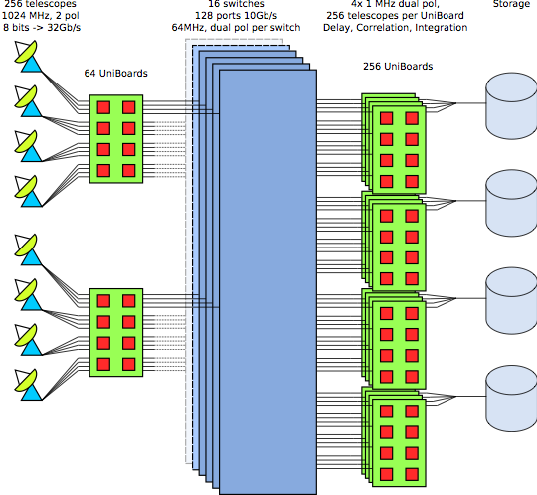
SKA mid-frequency correlator (1)
Mid-frequency:
256 telescopes
single pixel feeds
1024 MHz instantaneous bandwidth
2 pols
8 bits representation
7.5 kHz maximum resolution
0.1 s minimum dump time

Slide 12
SKA mid-frequency correlator (2)
Make use of excellent switching capability of UniBoard

Slide 13
SKA mid-frequency correlator (3)
384 boards
~170 kW
~3.8 Meuro
Feasible…

Slide 14
SKA low-frequency beam former
Low-frequency:
Number of stations: 50
Number of polarisations: 2
Number of antennas / station: 11200
Input bandwidth: 500 MHz
Output bandwidth: 380 MHz
Number of beams: 160
Number of input bits from the station ADC: 8
Number of output bits to the correlator: 4 x 2
Subband width: 125 kHz
Channel width: 1 kHz

Slide 15
SKA low-frequency correlator
50 stations, 160 beams
(correlation + beam forming)
9414 boards
90 Meuro
3.3 Mwatt
But, currently available hardware
~2 generations of FPGA until 2015

Slide 16
Next: UniBoard²
Possible Joint Research Activity in RadioNet3, follow-up of current project, start date 2012 (if approved by EC) (looking good)
Received strong support from RadioNet community
Same basic idea, development of generic hardware complemented by a number of applications
Consolidate and build on expertise obtained through UniBoard project
Strong emphasis on power efficiency (green computing)
Production-ready in 2015/2016
Complete re-design, using the next generation 28 nm FPGAs, possibly one generation beyond that (some slack in start date of project)
Non-leaded components
Possible use of 40GE, 100GE
Investigation into effects of hard-copy and partial hard-copy
Tuning of algorithms and firmware design to minimize power consumption
Balancing of system parameters and performance to minimize power consumption
Standardized interfaces and coding conventions to facilitate sharing and re-use of firmware blocks among developers of different applications

