Slide 1
Improvement of PCAL Signal Distribution
on RT-32 Radio Telescopes
of «Quasar» VLBI Network
Dmitry Marshalov
Evgeny Nosov
Institute of Applied Astronomy
Russian Academy of Sciences

Slide 2
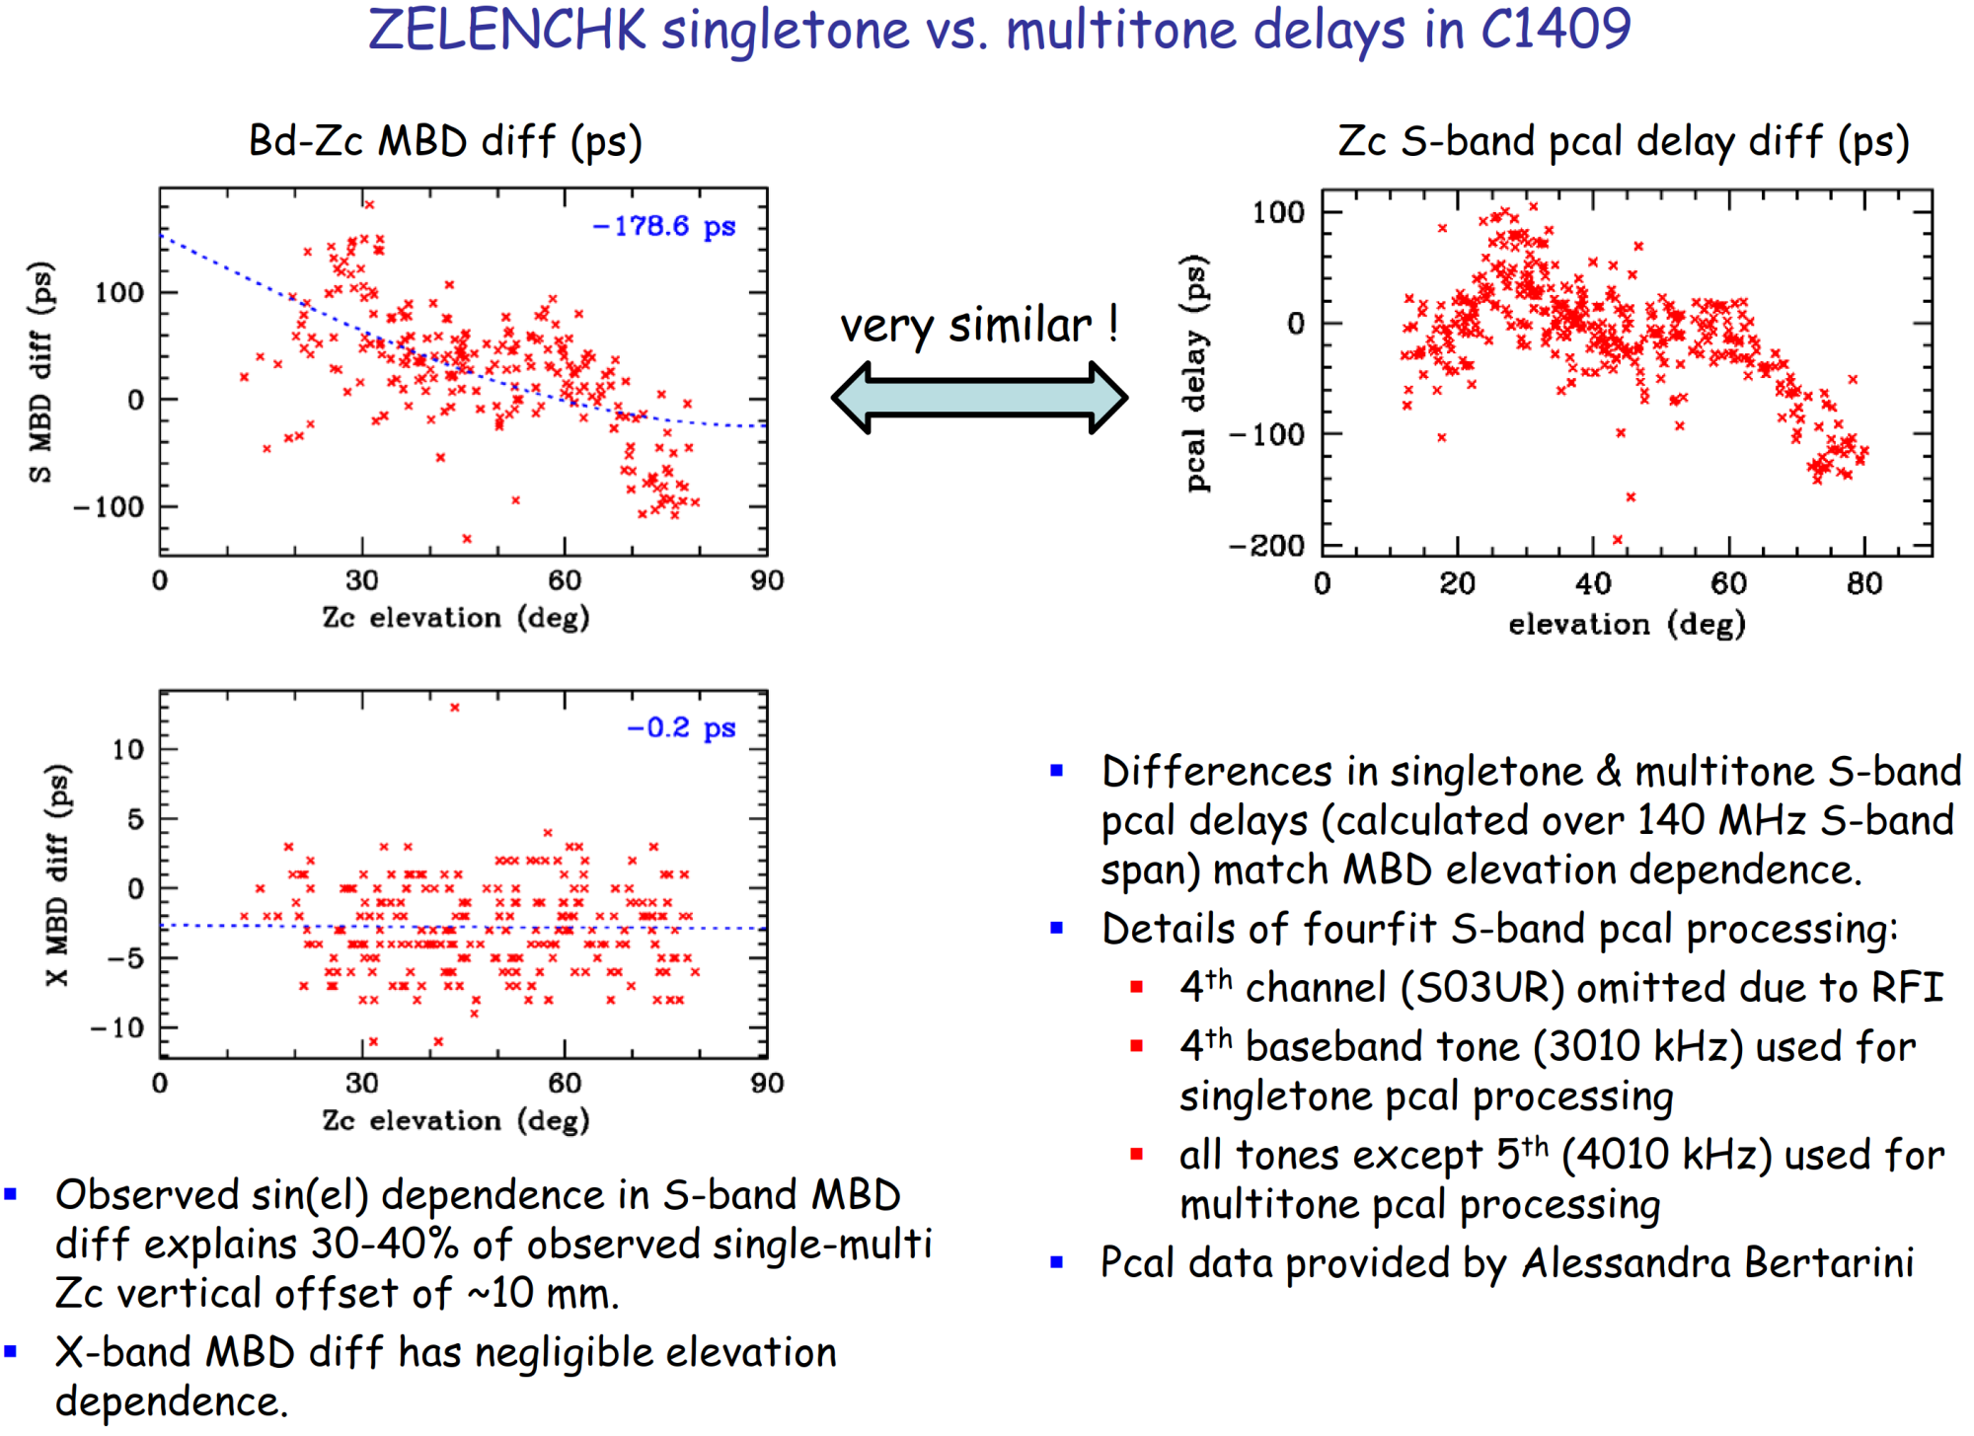
This slide is provided by Brian Corey

Slide 3
Experiment in Zelenchukskaya
Changing the antenna elevation from 80 deg. to 10 deg. with 5 deg. step.
Recording 1 min. scans for each elevation step
8 channels in X-band, 6 channels in S-band, USB, 8 MHz bandwidth, 1-bit
Extracting PCAL signal in all channels in time domain by coherent integration and frequency shift
Calculating amplitude and phase for all tones in all channels for each second of data (by FFT)
Unwrapping phase in time and frequency, remove “bad” tones
Calculating difference of phases for all seconds relative to first second
Calculating delay by fitting line to phase plot over all channels in a band

Slide 4
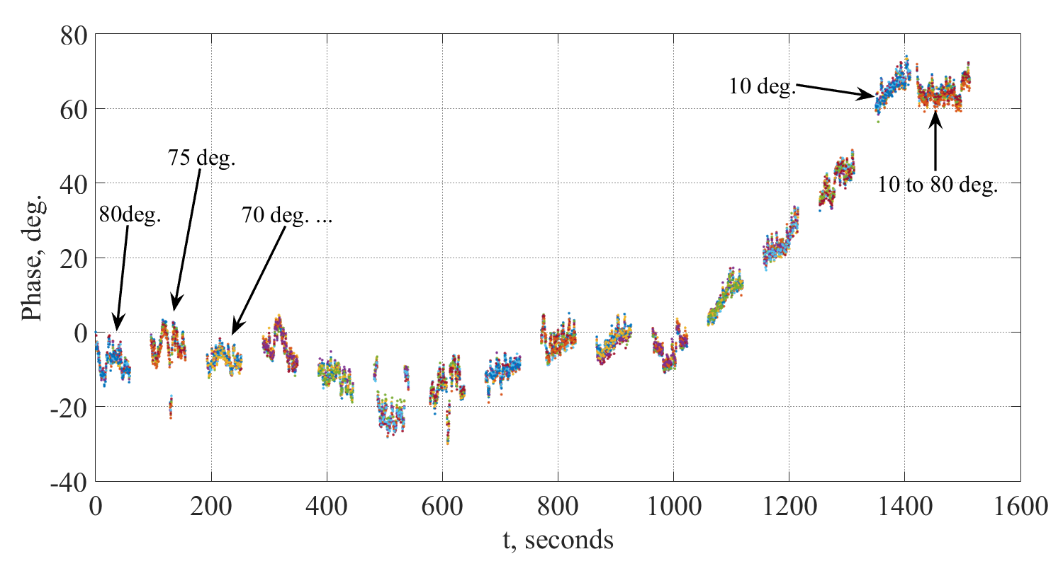
Phase of PCAL tones in X1 channel, Zc

Slide 5
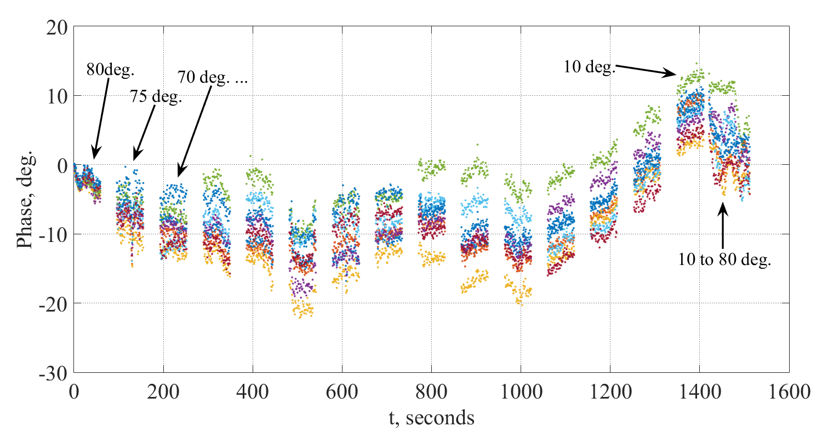
Phase of PCAL tones in S1 channel, Zc

Slide 6
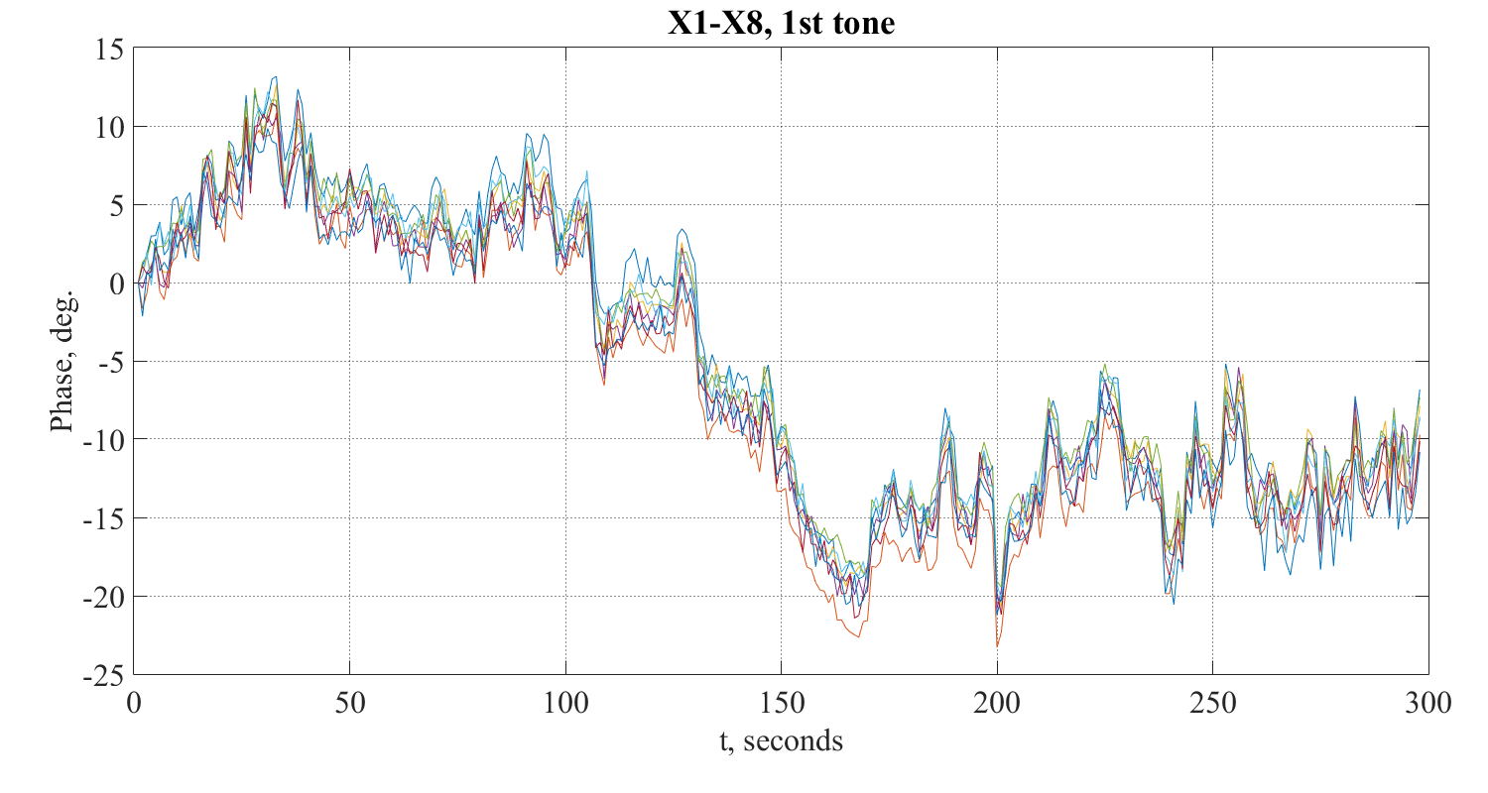
Phase of PCAL 1st tone in all X channels, Zc
Elevation changing from 80 to 10 deg. and back.

Slide 7
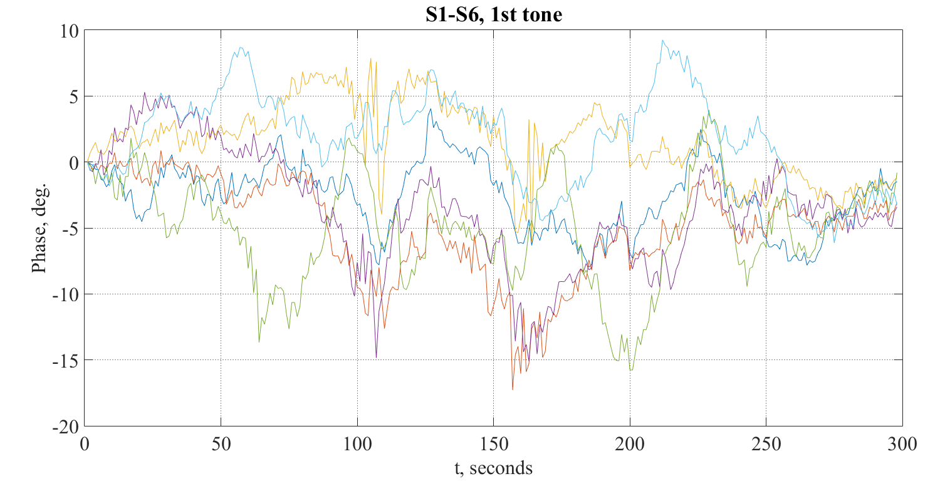
Phase of PCAL 1st tone in all S channels, Zc
Elevation changing from 80 to 10 deg. and back.

Slide 8
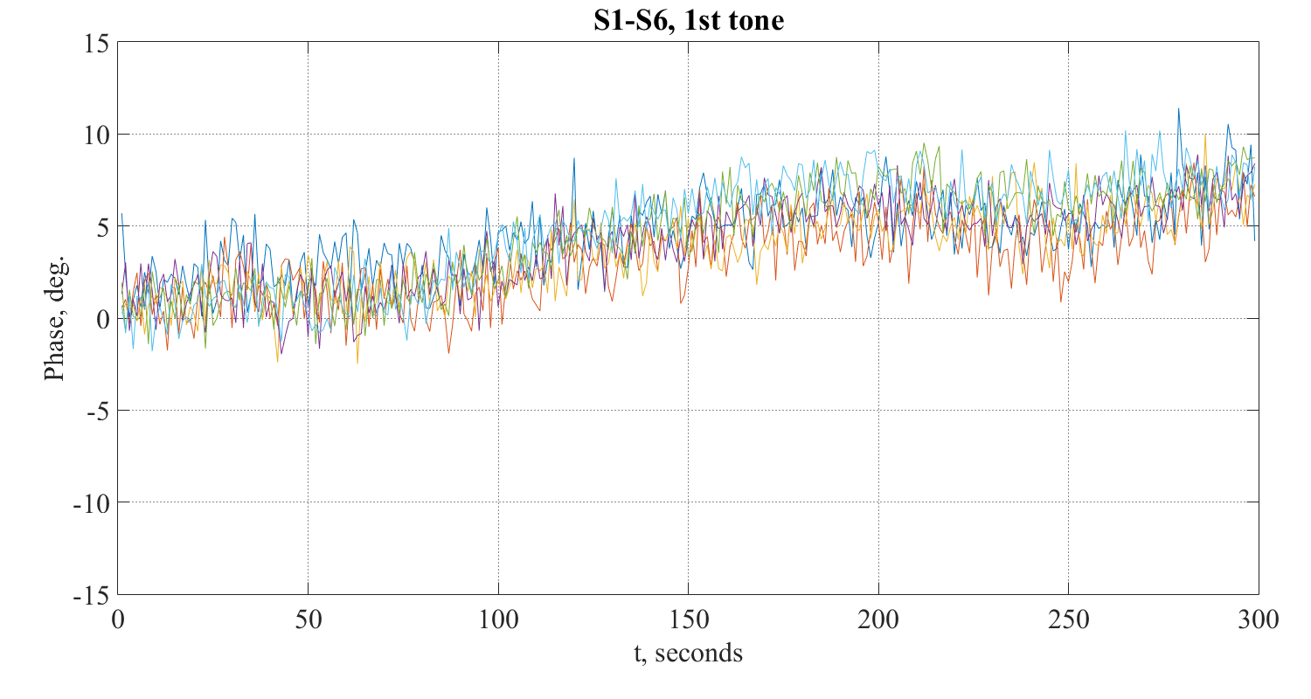
Phase of PCAL 1st tone in all S channels, Badary
Elevation changing from 80 to 10 deg. and back.

Slide 9
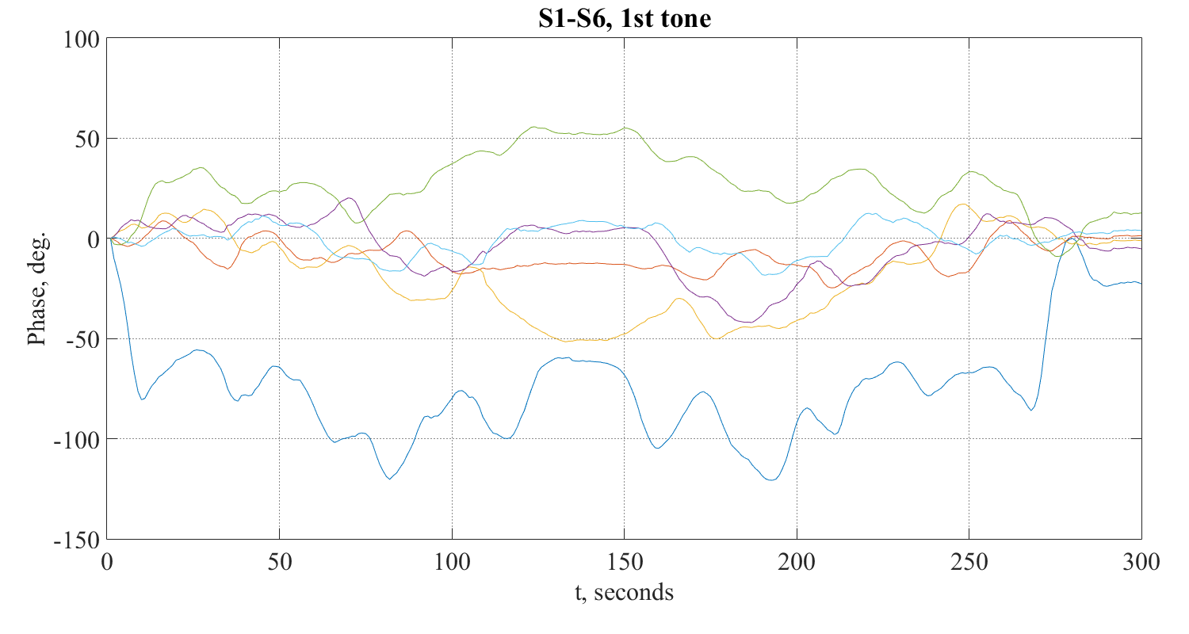
Phase of PCAL 1st tone in all S channels, Svetloe
Elevation changing from 80 to 10 deg. and back.

Slide 10
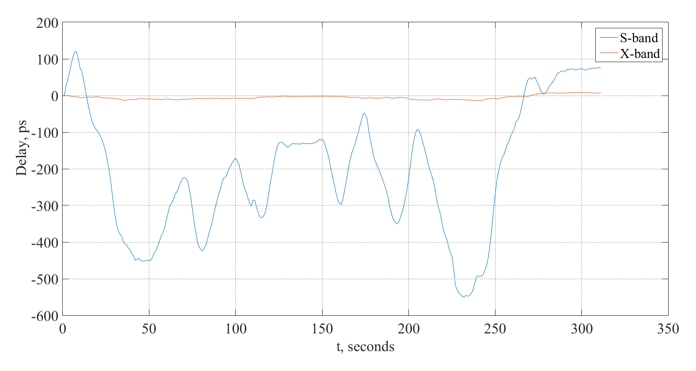
Synthesized PCAL delay in X- and S-bands, Sv (28.11.2016)
Elevation changing from 80 to 10 deg. and back.

Slide 11
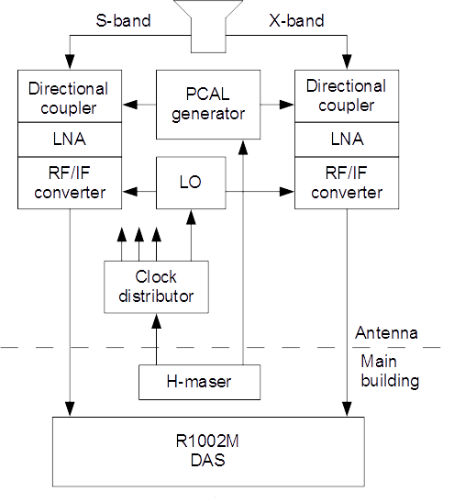
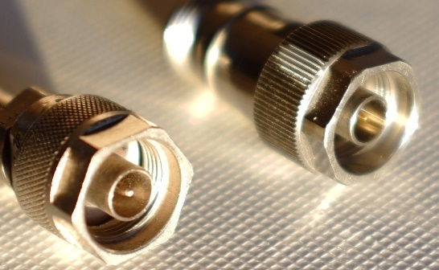
Simplified schematic of signal chain in Svetloe
What we were looking for:
Unfixed cables, impedance mismatch, parasitic propagation way, saturation, RFI?
What we have found:
Strong parasitic way of PCAL injection through the feed.
Fracture in PCAL injection cable for X-band
Inappropriate connectors type
Unfixed cables
Attenuator on a far side of PCAL cable
Bad grounding of LO reference clock connector.

Slide 12
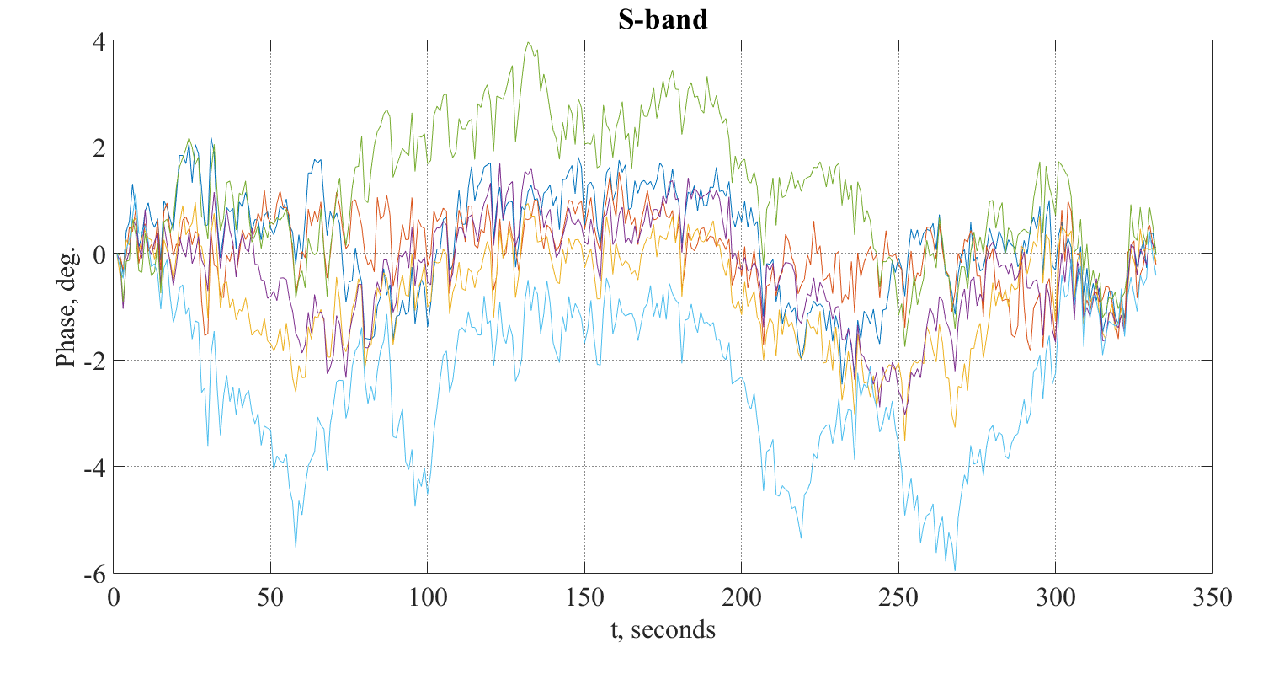
Phase of PCAL 1st tone in all S channels
after problems were fixed, Sv
Elevation changing from 10 to 80 deg. and back.

Slide 13
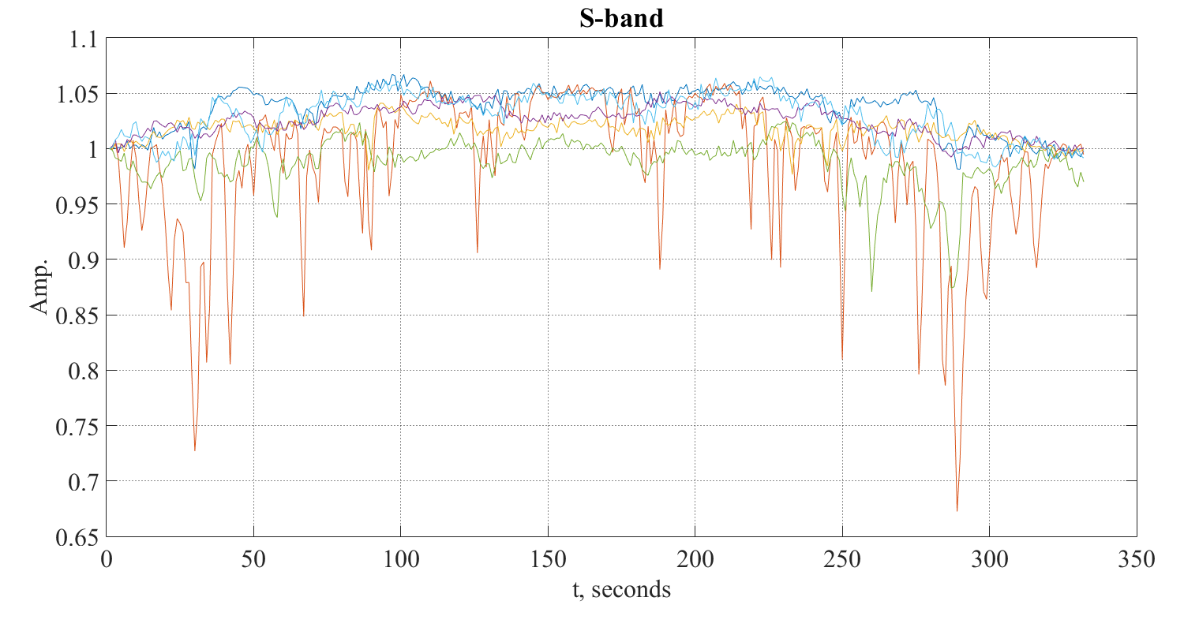
Influence of RFI on PCAL amplitude, Sv
Elevation changing from 10 to 80 deg. and back.

Slide 14
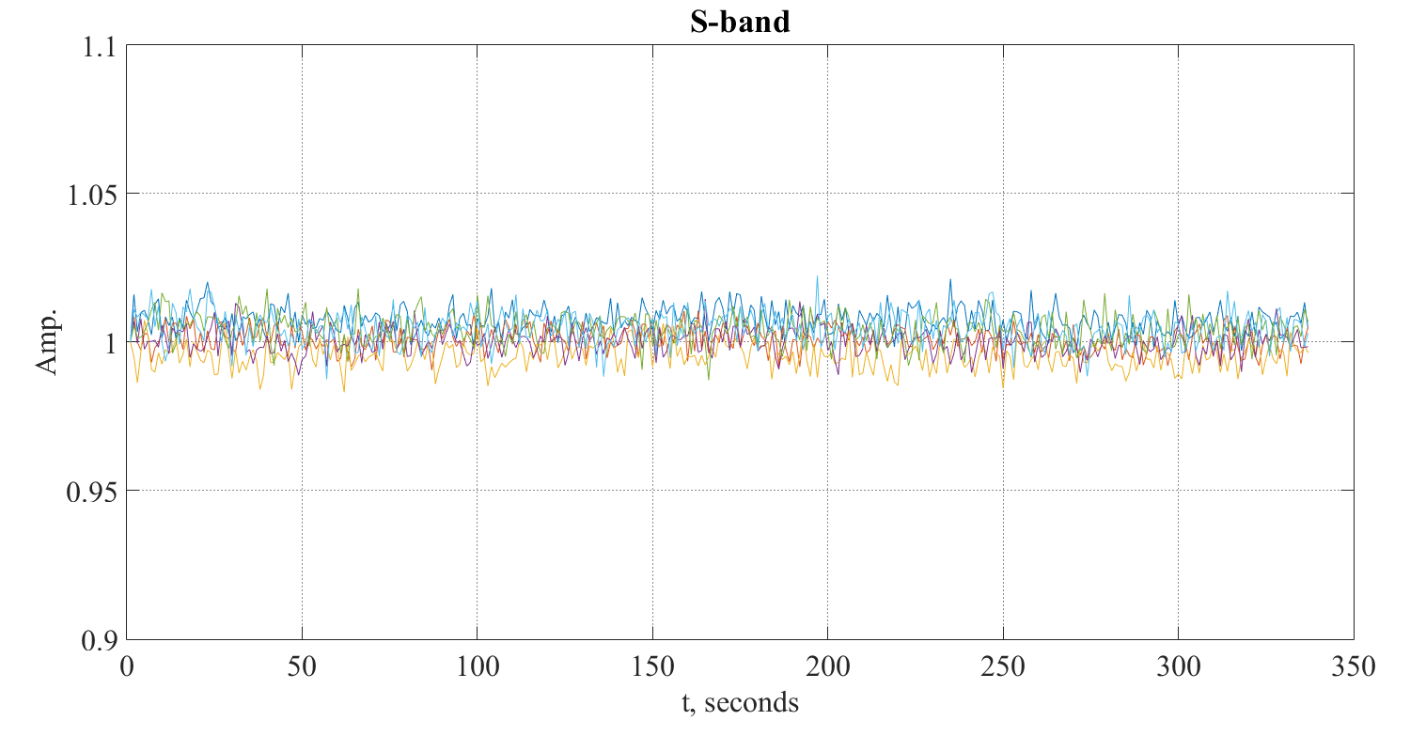
PCAL tones amplitude in S-band with disconnected feed, Sv
Elevation changing from 10 to 80 deg. and back.
Input of receiver is terminated to 50 Ohm.

Slide 15
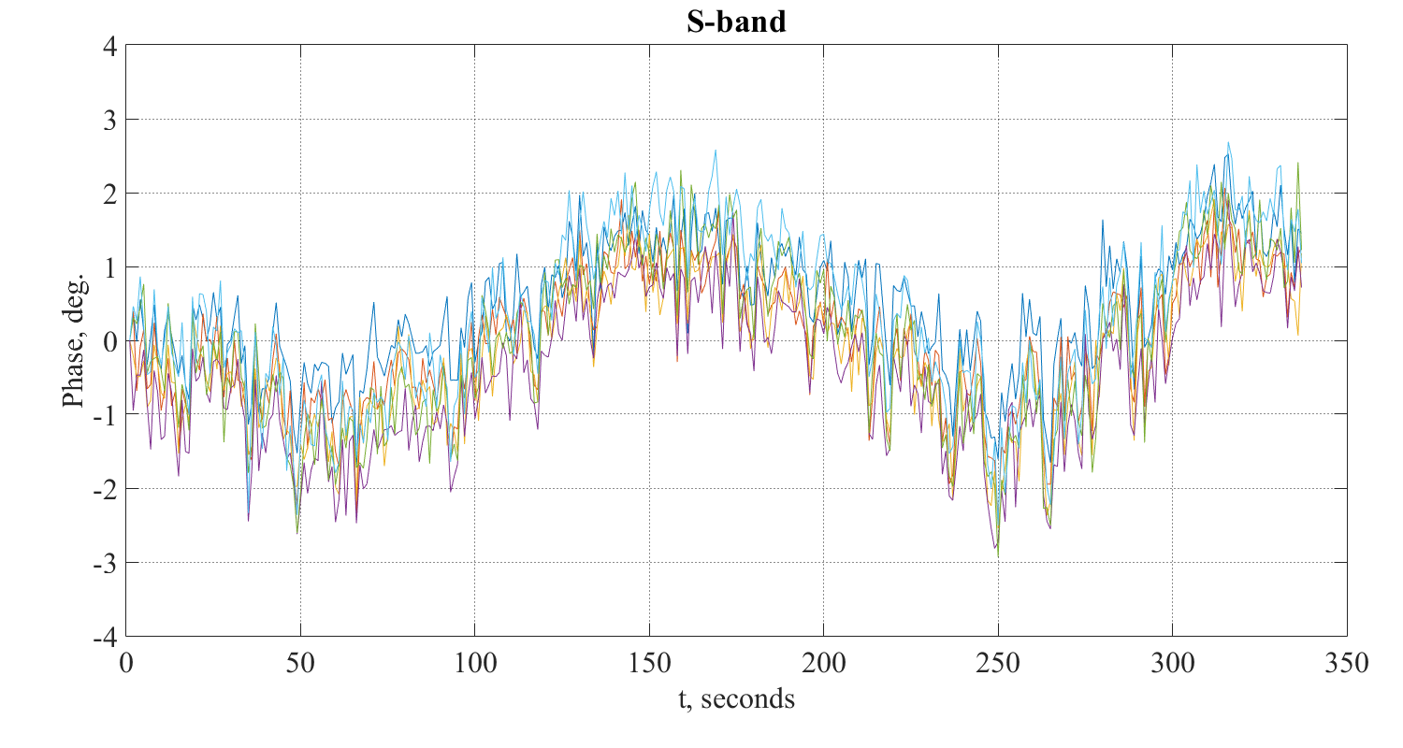
Phase of PCAL 1st tone in all S channels
with disconnected feed, Sv
Elevation changing from 10 to 80 deg. and back.
Input of receiver is terminated to 50 Ohm.

Slide 16
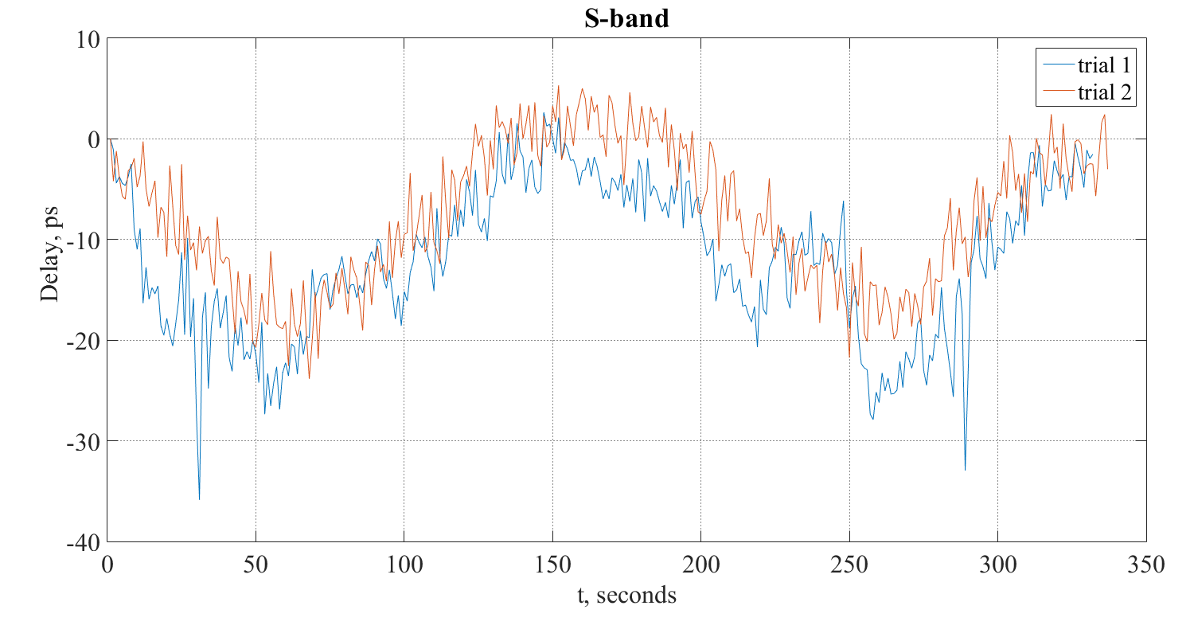
Synthesized PCAL delay in S-bands, Sv (11.05.2017)
Elevation changing from 10 to 80 deg. and back.
Line 1 (blue) - receiver is connected to feed
Line 2 (red) - receiver is terminated to 50 Ohm.

Slide 17
Summary
PCAL signal is a strong source of RFI. Good shielding and impedance matching are required to decrease radiation and eliminate parasitic propagation ways
Locate attenuators (if required) as close as possible to PCAL generator to reduce radiation
All cables should be tightly fixed to improve stability and prevent its degradation and dependence on antenna elevation. Reliable connector sealing should be provided
In the Svetloe station the delay variation was decreased from 500 to 10 picoseconds after performed works.
PCAL distribution on Zelenchukskaya station still needs careful examination. Appropriate PCAL injection cables were sent and installed on all stations
Periodical checks of PCAL quality during antenna movements help to control and prevent degradation of signal chain and clock distribution system
PCAL and clock distribution system will be reviewed during coming modernization of signal chain with new wideband digital backend.
Precise cable delay measurement system is required to separate delay variation in signal chain from variation of reference clock. Extremely important when formatter is located on the antenna

Slide 18
THANK YOU FOR ATTENTION!

Slide 19
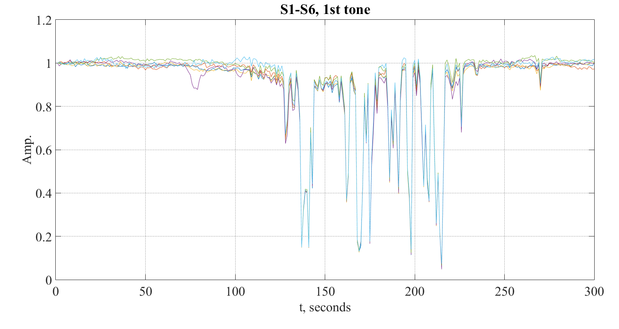
Effect of bad connector-to-cable grounding for 5 MHz signal
PCAL tones amplitude for S-band

Slide 20
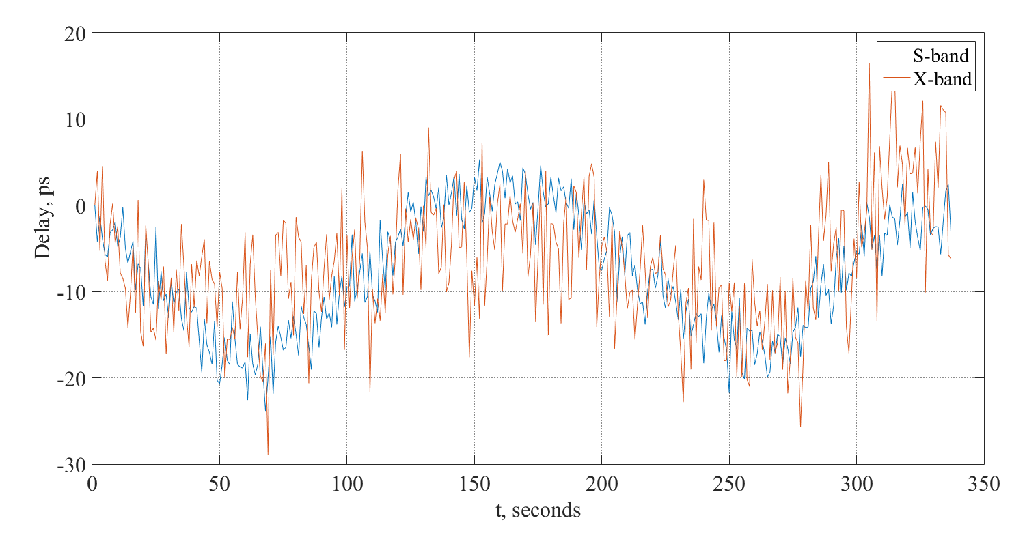
Comparison of PCAL delay in S- and X-bands, Sv
Elevation changing from 10 to 80 deg. and back.
Line 1 (blue) – S-band, receiver is terminated to 50 Ohm
Line 2 (red) – X-band, receiver is connected to feed

