Slide 1
Signal Processing for
Aperture Arrays

Slide 2
AAVS1
Assumption:
256 antenna elements distributed over
  4 stations
  64 elements each

Slide 3
AAVS1 Setup
64 elements
Station 1
Station 2
Station 3
Station 4
Correlator

Slide 4
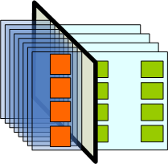
Station architecture
Receiver board
Digital processing board
X pol.
Antennas
Y pol.
Antennas
Architecture: ADCs centrally

Slide 5
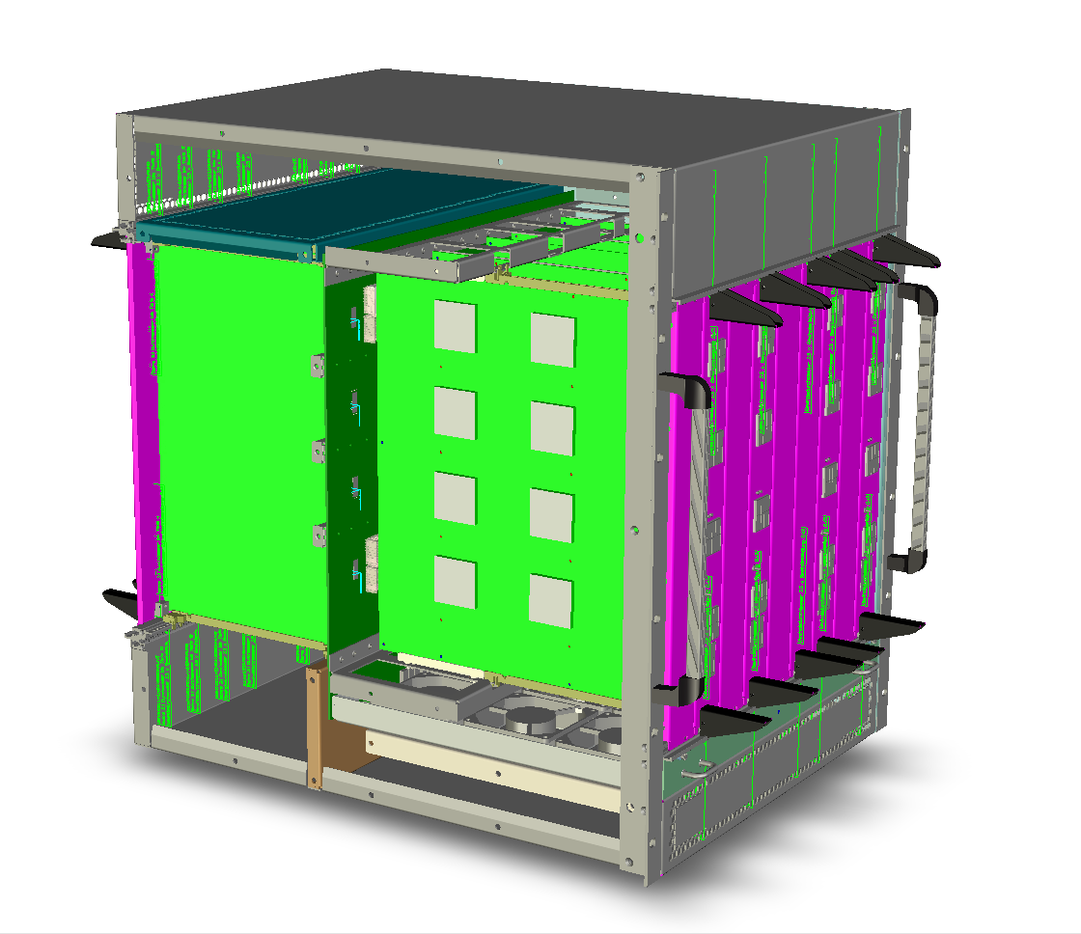
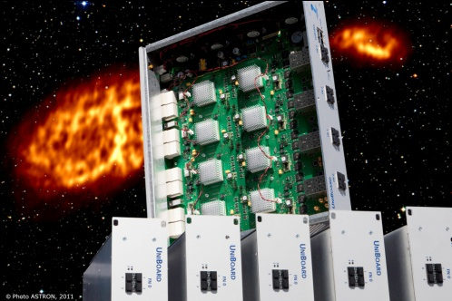
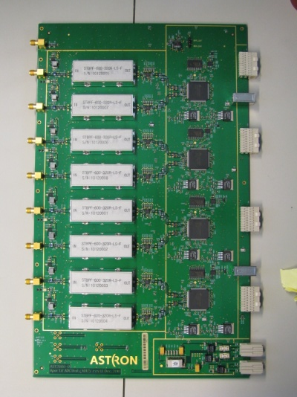
UniBoard Related Hardware
ADU
UniBoard
Presented December 2011

Slide 6
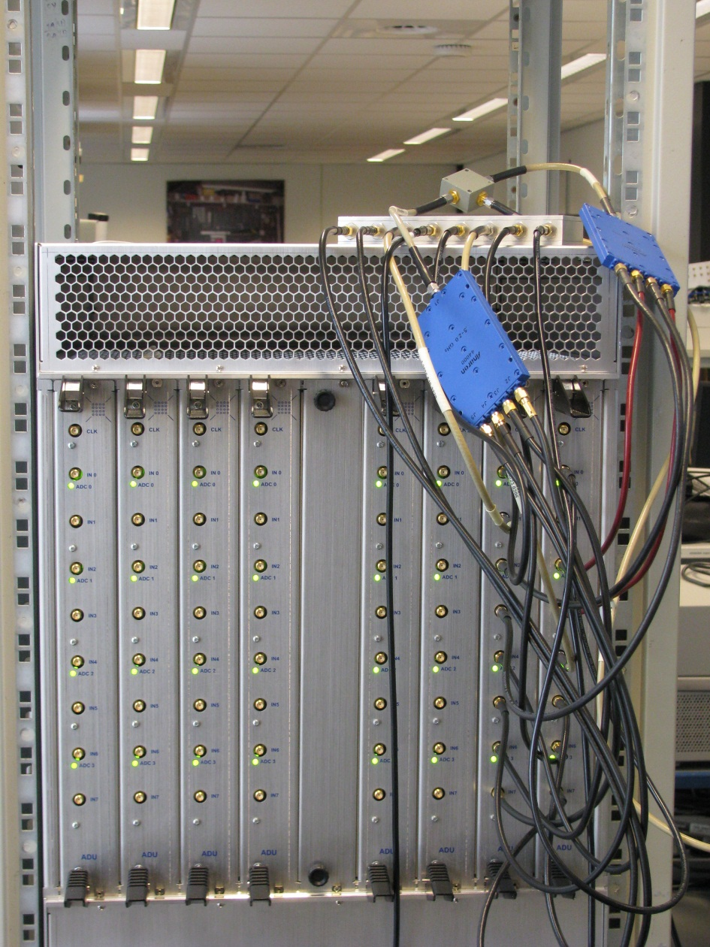
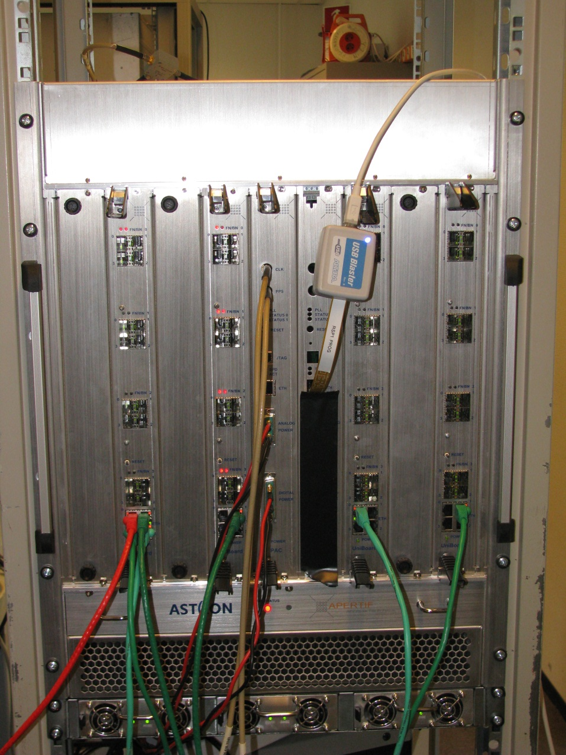
Current Status

Slide 7
Hardware Numbers
ADU
  400-800 MHz (can be modified)
  Dual ADC with fmax=1 GHz
  8 bit
UniBoard
  16 signal paths
  Input bandwidth: 400 MHz
  Output bandwidth: 40 beams of 300 MHz

Slide 8
Required changes for AAVS1
ADU filter removed
Sampling @ 1 GHz
UniBoard input bandwidth 1 GHz

Slide 9
How much hardware required?
Per AAVS1 station: 2*64/16 = 8 UniBoards
(2 represents X and Y pol.)
Total: 32 UniBoards required

Slide 10
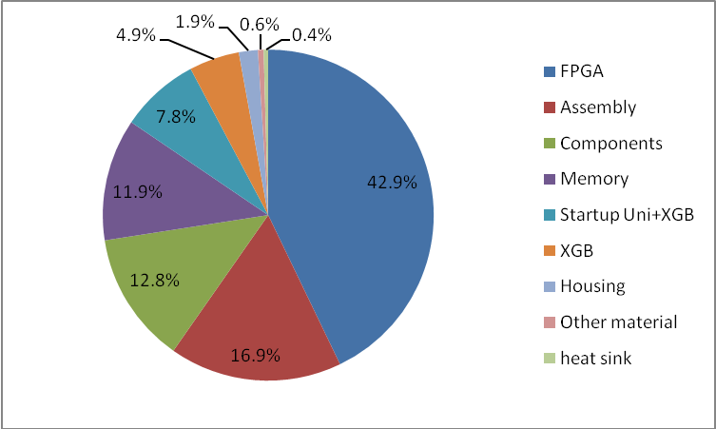
UniBoard Cost Breakdown

Slide 11
UniBoard2
Seeking for applications
My (ASTRON hat) take: AAVS2 towards SKA1 will be the main application

Slide 12
SKA1 Station
Number of elements: 11,264
Input bandwidth per element: 500 MHz
Total output bandwith: 1 Tbps
Two-stage beamforming
  First stage options:
    Integrated with ADC near antennas
    Analog/digital beamforming
    Centrally
  Second stage option:
    Implemented centrally for 11,264.y/x with x amount of combined elements in first stage and y amount of independent beams formed

Slide 13
Number of required boards
Total input data rate:
2*11,264*8 bit * 1 G = 360 Tbps
Current amount of 8 bit receiver inputs:
  16
UniBoard2 (assumed):
  64
Required max. UniBoard2 resources^{*)}:
  2*176 boards (assumes 8 FPGAs/board)
*) If input bandwidth is the bottle neck

Slide 14
Signal processing design
And dependent on how smart we design, we will need less in the end
This is an upper bound (disclaimer if bandwidth is the bottle neck)
Example if we have a chip wherein 16 ADCs are combined and a first stage digital beamformer we need 16x boards less

Slide 15
UniBoard2 Initial Ideas
FPGA technology: 20 nm
Focused on power reduction
  Component selection
  Production (lead free now)
  Components switched off when not used
  etc.
Interfaces: 2x4x25G per FPGA (QSFP+)
≥ 8 FPGAs
Backplane oriented (to built larger, dense systems)
≥ 4 times more processing
≥ 4 more receiver input bandwidth
Prototype available in 2014
SKA could and should drive the design decisions …

